Slide 1

220 / 319: Recursion The Art of Self Reference
https://en.wikipedia.org/
Meena Syamkumar
Andy Kuemmel

Slide 2
Part 2 of CS220 / CS319 - Data Structures
Lists and Dictionaries
CSV and JSON
Objects and References
Fancy Functions
Recursion
Functions are Objects
Iterators and comprehensions
Error handling
Files and directories

Slide 3
Goal: use self-reference is a meaningful way
Hofstadter's Law: “It always takes longer than you expect, even when you take into account Hofstadter's Law.”
(From Gödel, Escher, Bach)
good advice for CS assignments!

Slide 4
Goal: use self-reference is a meaningful way
Hofstadter's Law: “It always takes longer than you expect, even when you take into account Hofstadter's Law.”
(From Gödel, Escher, Bach)
mountain: “a landmass that projects conspicuously above its surroundings and is higher than a hill”
hill: “a usually rounded natural elevation of land lower than a mountain”
(Example of unhelpful self reference from Merriam-Webster dictionary)
https://en.wikipedia.org/wiki/Circular_definition

Slide 5
Learning Objectives
Recursive definitions and recursive information
What is a recursive definition/structure?
Recursive code
What is recursive code?
Why write recursive code?
Where do computers keep local variables for recursive calls?
What happens to programs with infinite recursion?
Read Think Python
Ch 5: “Recursion” through “Infinite Recursion”
Ch 6: “More Recursion” through end

Slide 6
What is Recursion?
Recursive definitions
Contain the term in the body
Dictionaries, mathematical definitions, etc
A number x is a positive even number if:
x is 2
OR
x equals another positive even number plus two

Slide 7
What is Recursion?
Recursive structures may refer to structures of the same type
data structures or real-world structures
rows = [
[“A”, [1, 2]],
[“B”, [3, 4, 5]],
[“C”, [6, 7]]
]
rows
“A”
“B”
“C”
1
2
3
4
5
6
7

Slide 8

Recursive structures are EVERYWHERE!
files
{
“name”: “alice”,
“grade”: “A”,
“score”: 96,
“exams”: {
“midterm”: {“points”:94,
“total”:100},
“final”: {“points”: 98,
“total”: 100}
}
}
directories
nature
files
formats

Slide 9
Example: Trees (Direct Recursion)
Term: branch
Definition: wooden stick, with an end splitting into other branches, OR terminating with a leaf
?

Slide 10
Example: Trees (Direct Recursion)
Term: branch
?
?
Definition: wooden stick, with an end splitting into other branches, OR terminating with a leaf
?

Slide 11
Example: Trees (Direct Recursion)
Term: branch
?
?
?
?
?
Definition: wooden stick, with an end splitting into other branches, OR terminating with a leaf

Slide 12
Example: Trees (Direct Recursion)
Term: branch
Definition: wooden stick, with an end splitting into other branches, OR terminating with a leaf
recursive case allows
indefinite growth
trees are finite:
eventual base case
allows completion

Slide 13
base case (leaf)
recursive case (branch)

Slide 14
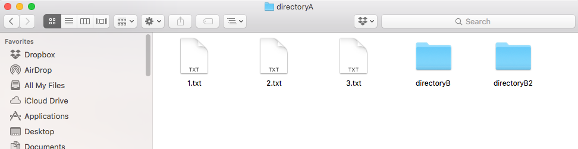
Example: Directories (aka folders)
Term: directory
recursive because def contains term
Definition: a collection of files and directories

Slide 15
Example: Directories (aka folders)
Term: directory
recursive because def contains term
Definition: a collection of files and directories
file system tree

Slide 16
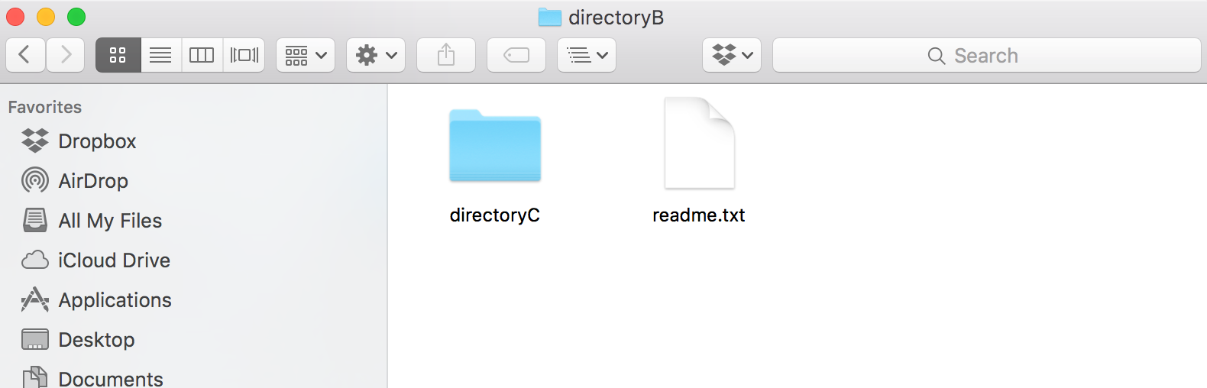
Example: Directories (aka folders)
Term: directory
recursive because def contains term
Definition: a collection of files and directories
file system tree

Slide 17

Example: Directories (aka folders)
Term: directory
recursive because def contains term
Definition: a collection of files and directories
file system tree

Slide 18
Example: JSON Format (Indirect Recursion)
Example JSON Dictionary:
{
“name”: “alice”,
“grade”: “A”,
“score”: 96
}

Slide 19
Example: JSON Format (Indirect Recursion)
Example JSON Dictionary:
{
“name”: “alice”,
“grade”: “A”,
“score”: 96
}
Term: json-dict Def: a set of json-mapping's
Term: json-mapping Def: a json-string (KEY) paired with a json-string OR json-number OR json-dict (VALUE)
keys
values
recursive self reference isn’t always direct!

Slide 20
Example: JSON Format (Indirect Recursion)
Example JSON Dictionary:
{
“name”: “alice”,
“grade”: “A”,
“score”: 96,
“exams”: {
“midterm”: {“points”:94,
“total”:100},
“final”: {“points”: 98,
“total”: 100}
}
}
Term: json-dict Def: a set of json-mapping's
Term: json-mapping Def: a json-string (KEY) paired with a json-string OR json-number OR json-dict (VALUE)

Slide 21
Learning Objectives
Recursive definitions and recursive information
What is a recursive definition/structure?
Recursive code
What is recursive code?
Why write recursive code?
Where do computers keep local variables for recursive calls?
What happens to programs with infinite recursion?
Read Think Python
Ch 5: “Recursion” through “Infinite Recursion”
Ch 6: “More Recursion” through end

Slide 22
Recursive Code
What is it?
A function that calls itself (possible indirectly)
call
f
g
h
call
call

Slide 23
Recursive Code
What is it?
A function that calls itself (possible indirectly)
call
def f():
# other code
f()
# other code
g
h
call

Slide 24
Recursive Code
What is it?
A function that calls itself (possible indirectly)
def g():
# other code
h()
# other code
def h():
# other code
g()
# other code
def f():
# other code
f()
# other code

Slide 25
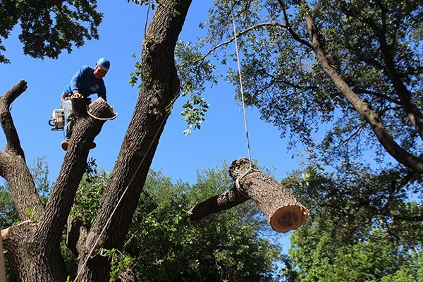
Recursive Code
What is it?
A function that calls itself (possible indirectly)
Motivation: don’t know how big the data is before execution
Need either iteration or recursion
In theory, these techniques are equally powerful
Why use recursion?
simple and elegant solution
recursive code corresponds to recursive data
reduce a big problem into a smaller problem
https://texastreesurgeons.com/services/tree-removal/

Slide 26
Recursive Student Counting
CS220 students
in the front row
Professor with a question
Example from https://courses.cs.washington.edu/courses/cse143/17au/

Slide 27
Recursive Student Counting
Constraints:
You can only talk to the student behind / in front of you
What should each student ask the person behind them?
How many students
are in this column?
Example from https://courses.cs.washington.edu/courses/cse143/17au/

Slide 28
Recursive Student Counting
Strategy: reframe question as “how many students are behind you?”
Process: if nobody is behind you: say 0 else: ask them, say their answer+1
Reframing is the hardest part!
how many are behind you?
Example from https://courses.cs.washington.edu/courses/cse143/17au/

Slide 29
Recursive Student Counting
how many are behind you?
how many are behind you?
Strategy: reframe question as “how many students are behind you?”
Process: if nobody is behind you: say 0 else: ask them, say their answer+1
how many are behind you?
how many are behind you?
how many are behind you?
Example from https://courses.cs.washington.edu/courses/cse143/17au/

Slide 30
Recursive Student Counting
20
21
Strategy: reframe question as “how many students are behind you?”
Process: if nobody is behind you: say 0 else: ask them, say their answer+1
Observations:
Each student runs the same “code”
Each student has their own “state”
22
23
24
Aha! Clearly there must
be 25 students in this
column
Example from https://courses.cs.washington.edu/courses/cse143/17au/

Slide 31
Practice: Reframing Factorials
N! = 1 x 2 x 3 x … x (N-2) x (N-1) x N

Slide 32
Example: Factorials
1. Examples:
3. Recursive Definition:
1! = 1
2! = 1*2 = 2
3! = 1*2*3 = 6
4! = 1*2*3*4 = 24
5! = 1*2*3*4*5 = 120
4. Python Code:
def fact(n):
pass # TODO
2. Self Reference:
Goal: work from examples to get to recursive code

Slide 33
Example: Factorials
1. Examples:
3. Recursive Definition:
simplest example
1! = 1
2! = 1*2 = 2
3! = 1*2*3 = 6
4! = 1*2*3*4 = 24
5! = 1*2*3*4*5 = 120
4. Python Code:
def fact(n):
pass # TODO
2. Self Reference:
Goal: work from examples to get to recursive code

Slide 34
Example: Factorials
1. Examples:
3. Recursive Definition:
1! = 1
2! = 1*2 = 2
3! = 1*2*3 = 6
4! = 1*2*3*4 = 24
5! = 1*2*3*4*5 = 120
4. Python Code:
def fact(n):
pass # TODO
2. Self Reference:
look for patterns that allow
rewrites with self reference

Slide 35
Example: Factorials
1. Examples:
3. Recursive Definition:
1! = 1
2! = 1*2 = 2
3! = 1*2*3 = 6
4! = 1*2*3*4 = 24
5! = 1*2*3*4*5 = 120
4. Python Code:
def fact(n):
pass # TODO
2. Self Reference:
1! =
2! =
3! =
4! =
5! = 4! * 5

Slide 36
Example: Factorials
1. Examples:
3. Recursive Definition:
1! = 1
2! = 1*2 = 2
3! = 1*2*3 = 6
4! = 1*2*3*4 = 24
5! = 1*2*3*4*5 = 120
4. Python Code:
def fact(n):
pass # TODO
2. Self Reference:
1! =
2! =
3! =
4! = 3! * 4
5! = 4! * 5

Slide 37
Example: Factorials
1. Examples:
3. Recursive Definition:
1! = 1
2! = 1*2 = 2
3! = 1*2*3 = 6
4! = 1*2*3*4 = 24
5! = 1*2*3*4*5 = 120
4. Python Code:
def fact(n):
pass # TODO
2. Self Reference:
1! =
2! = 1! * 2
3! = 2! * 3
4! = 3! * 4
5! = 4! * 5

Slide 38
Example: Factorials
1. Examples:
3. Recursive Definition:
1! = 1
2! = 1*2 = 2
3! = 1*2*3 = 6
4! = 1*2*3*4 = 24
5! = 1*2*3*4*5 = 120
4. Python Code:
def fact(n):
pass # TODO
2. Self Reference:
1! = 1
2! = 1! * 2
3! = 2! * 3
4! = 3! * 4
5! = 4! * 5
don’t need a pattern
at the start

Slide 39
Example: Factorials
1. Examples:
3. Recursive Definition:
1! = 1
2! = 1*2 = 2
3! = 1*2*3 = 6
4! = 1*2*3*4 = 24
5! = 1*2*3*4*5 = 120
convert self-referring examples
to a recursive definition
4. Python Code:
def fact(n):
pass # TODO
2. Self Reference:
1! = 1
2! = 1! * 2
3! = 2! * 3
4! = 3! * 4
5! = 4! * 5

Slide 40
Example: Factorials
1. Examples:
3. Recursive Definition:
1! = 1
2! = 1*2 = 2
3! = 1*2*3 = 6
4! = 1*2*3*4 = 24
5! = 1*2*3*4*5 = 120
1! is 1
4. Python Code:
def fact(n):
pass # TODO
2. Self Reference:
1! = 1
2! = 1! * 2
3! = 2! * 3
4! = 3! * 4
5! = 4! * 5

Slide 41
Example: Factorials
1. Examples:
3. Recursive Definition:
1! = 1
2! = 1*2 = 2
3! = 1*2*3 = 6
4! = 1*2*3*4 = 24
5! = 1*2*3*4*5 = 120
1! is 1 N! is ???? for N > 1
4. Python Code:
def fact(n):
pass # TODO
2. Self Reference:
1! = 1
2! = 1! * 2
3! = 2! * 3
4! = 3! * 4
5! = 4! * 5

Slide 42
Example: Factorials
1. Examples:
3. Recursive Definition:
1! = 1
2! = 1*2 = 2
3! = 1*2*3 = 6
4! = 1*2*3*4 = 24
5! = 1*2*3*4*5 = 120
1! is 1 N! is (N-1)! * N for N > 1
4. Python Code:
def fact(n):
pass # TODO
2. Self Reference:
1! = 1
2! = 1! * 2
3! = 2! * 3
4! = 3! * 4
5! = 4! * 5

Slide 43
Example: Factorials
1. Examples:
3. Recursive Definition:
1! = 1
2! = 1*2 = 2
3! = 1*2*3 = 6
4! = 1*2*3*4 = 24
5! = 1*2*3*4*5 = 120
1! is 1 N! is (N-1)! * N for N > 1
4. Python Code:
def fact(n):
if n == 1:
return 1
2. Self Reference:
1! = 1
2! = 1! * 2
3! = 2! * 3
4! = 3! * 4
5! = 4! * 5

Slide 44
Example: Factorials
1. Examples:
3. Recursive Definition:
1! = 1
2! = 1*2 = 2
3! = 1*2*3 = 6
4! = 1*2*3*4 = 24
5! = 1*2*3*4*5 = 120
1! is 1 N! is (N-1)! * N for N > 1
4. Python Code:
def fact(n):
if n == 1:
return 1
p = fact(n-1)
return n * p
2. Self Reference:
1! = 1
2! = 1! * 2
3! = 2! * 3
4! = 3! * 4
5! = 4! * 5
Rule 1: Base case should always be defined and be terminal
Rule 2: Recursive case should make progress towards base case

Slide 45
Example: Factorials
1. Examples:
3. Recursive Definition:
1! = 1
2! = 1*2 = 2
3! = 1*2*3 = 6
4! = 1*2*3*4 = 24
5! = 1*2*3*4*5 = 120
1! is 1 N! is (N-1)! * N for N > 1
4. Python Code:
def fact(n):
if n == 1:
return 1
p = fact(n-1)
return n * p
2. Self Reference:
1! = 1
2! = 1! * 2
3! = 2! * 3
4! = 3! * 4
5! = 4! * 5
Let’s “run” it!

Slide 46
Tracing Factorial
def fact(n):
if n == 1:
return 1
p = fact(n-1)
return n * p
How does Python keep
all the variables separate?
frames to the rescue!

Slide 47
Deep Dive: Invocation State
In recursion, each function invocation has its own state, but multiple invocations share code.
Variables for an invocation exist in a frame
frames are stored in the stack
one invocation is active at a time: its frame is on the top of stack
multiple frames at the same time for the multiple invocations of the same function
variables
fact
frame:
stack:
fact
fact
fact
global

Slide 48
Deep Dive: Runtime Stack
def fact(n):
if n == 1:
return 1
p = fact(n-1)
return n * p
call fact(3)
Current
Runtime Stack
global
0
1
2
3
4
5
6
time

Slide 49
Deep Dive: Runtime Stack
def fact(n):
if n == 1:
return 1
p = fact(n-1)
return n * p
Current
Runtime Stack
fact
n=3
new, active frame
global
global
0
1
2
3
4
5
6
time

Slide 50
Deep Dive: Runtime Stack
def fact(n):
if n == 1:
return 1
p = fact(n-1)
return n * p
fact
n=3
p=
global
global
0
1
2
3
4
5
6
time

Slide 51
Deep Dive: Runtime Stack
def fact(n):
if n == 1:
return 1
p = fact(n-1)
return n * p
fact
n=2
fact
n=3
p=
fact
n=3
p=
global
global
global
0
1
2
3
4
5
6
time

Slide 52
Deep Dive: Runtime Stack
def fact(n):
if n == 1:
return 1
p = fact(n-1)
return n * p
fact
n=2
p=
fact
n=3
p=
fact
n=3
p=
global
global
global
0
1
2
3
4
5
6
time

Slide 53
Deep Dive: Runtime Stack
def fact(n):
if n == 1:
return 1
p = fact(n-1)
return n * p
fact
n=1
fact
n=2
p=
fact
n=2
p=
fact
n=3
p=
fact
n=3
p=
fact
n=3
p=
global
global
global
global
0
1
2
3
4
5
6
time

Slide 54
Deep Dive: Runtime Stack
def fact(n):
if n == 1:
return 1
p = fact(n-1)
return n * p
fact
n=1
return 1 (base case)
fact
n=2
p=
fact
n=2
p=
fact
n=3
p=
fact
n=3
p=
fact
n=3
p=
global
global
global
global
0
1
2
3
4
5
6
time

Slide 55
Deep Dive: Runtime Stack
def fact(n):
if n == 1:
return 1
p = fact(n-1)
return n * p
fact
n=1
return 1 (base case)
fact
n=2
p=
fact
n=2
p=
fact
n=2
p=
fact
n=3
p=
fact
n=3
p=
fact
n=3
p=
fact
n=3
p=
global
global
global
global
global
0
1
2
3
4
5
6
time

Slide 56
Deep Dive: Runtime Stack
def fact(n):
if n == 1:
return 1
p = fact(n-1)
return n * p
fact
n=1
return 1 (base case)
fact
n=2
p=
fact
n=2
p=
fact
n=2
p=1
fact
n=3
p=
fact
n=3
p=
fact
n=3
p=
fact
n=3
p=
global
global
global
global
global
0
1
2
3
4
5
6
time

Slide 57
Deep Dive: Runtime Stack
def fact(n):
if n == 1:
return 1
p = fact(n-1)
return n * p
fact
n=1
return 1 (base case)
fact
n=2
p=
fact
n=2
p=
fact
n=2
p=1
return 2 (n*p)
fact
n=3
p=
fact
n=3
p=
fact
n=3
p=
fact
n=3
p=
global
global
global
global
global
0
1
2
3
4
5
6
time

Slide 58
Deep Dive: Runtime Stack
def fact(n):
if n == 1:
return 1
p = fact(n-1)
return n * p
fact
n=1
return 1 (base case)
fact
n=2
p=
fact
n=2
p=
fact
n=2
p=1
return 2 (n*p)
fact
n=3
p=
fact
n=3
p=
fact
n=3
p=
fact
n=3
p=
fact
n=3
p=
global
global
global
global
global
global
0
1
2
3
4
5
6
time

Slide 59
Deep Dive: Runtime Stack
def fact(n):
if n == 1:
return 1
p = fact(n-1)
return n * p
fact
n=1
return 1 (base case)
fact
n=2
p=
fact
n=2
p=
fact
n=2
p=1
return 2 (n*p)
fact
n=3
p=
fact
n=3
p=
fact
n=3
p=
fact
n=3
p=
fact
n=3
p=2
global
global
global
global
global
global
0
1
2
3
4
5
6
time

Slide 60
Deep Dive: Runtime Stack
def fact(n):
if n == 1:
return 1
p = fact(n-1)
return n * p
fact
n=1
return 1 (base case)
fact
n=2
p=
fact
n=2
p=
fact
n=2
p=1
return 2 (n*p)
fact
n=3
p=
fact
n=3
p=
fact
n=3
p=
fact
n=3
p=
fact
n=3
p=2
return 6 (n*p)
global
global
global
global
global
global
0
1
2
3
4
5
6
time

Slide 61
Deep Dive: Runtime Stack
def fact(n):
if n == 1:
return 1
p = fact(n-1)
return n * p
fact
n=1
return 1 (base case)
fact
n=2
p=
fact
n=2
p=
fact
n=2
p=1
return 2 (n*p)
fact
n=3
p=
fact
n=3
p=
fact
n=3
p=
fact
n=3
p=
fact
n=3
p=2
return 6 (n*p)
global
global
global
global
global
global
global
0
1
2
3
4
5
6
time

Slide 62
“Infinite” Recursion Bugs
What happens if:
factorial is called with a negative number?
-1
def fact(n):
if n == 1:
return 1
p = fact(n-1)
return n * p
never
terminates

Slide 63
“Infinite” Recursion Bugs
What happens if:
factorial is called with a negative number?
we forgot the “n == 1” check?
fact
n=-1
fact
n=0
3
fact
n=1
def fact(n):
if n == 1:
return 1
p = fact(n-1)
return n * p
fact
n=2
fact
n=3
never
terminates
global

Slide 64
Let’s code

Slide 65
Example: Pretty Print
Goal: format nested lists of bullet points
Input:
The recursive lists
Output:
Appropriately-tabbed items
Example: >>> pretty_print([“A”, [“1”, “2”, “3”,], “B”, [“4”, [“i”, “ii”]]]) *A *1 *2 *3 *B *4 *i *ii

Slide 66
Practice: Recursive List Search
Goal: does a given number exist in a recursive structure?
Input:
A number
A list of numbers and lists (which contain other numbers and lists)
Output:
True if there’s a list containing the number, else False
Example: >>> contains(3, [1,2,[4,[[3],[8,9]],5,6]]) True >>> contains(12, [1,2,[4,[[3],[8,9]],5,6]]) False

Slide 67
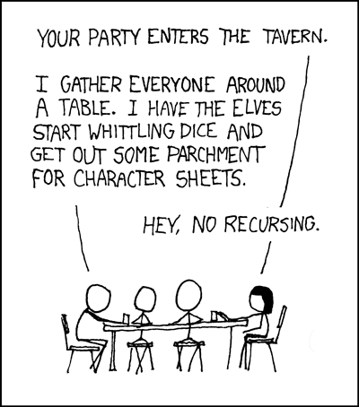

https://xkcd.com/244/
“To understand recursion, you need to understand recursion.”
(Meena)
https://hotsigns.net/two-thumbs-up-emoji-247-decal_p_302.html

Slide 68
Summary: Recursive Information
What is a recursive definition/structure?
Definition contains term
Structure refers to others of same type
Example: a dictionary contains dictionaries (which may contain...)
recursive case
base case

Slide 69
Learning Objectives: Recursive Code
What is recursive code?
Function that sometimes itself (maybe indirectly)
Why write recursive code?
Real-world data/structures are recursive; intuitive for code to reflect data
Where do computers keep local variables for recursive calls?
In a section of memory called a “frame”
Only one function is active at a time, so keep frames in a stack
What happens to programs with infinite recursion?
Calls keep pushing more frames
Exhaust memory, throw StackOverflowError

